Slide 1
Conversation and practices
Lesson two

Slide 2
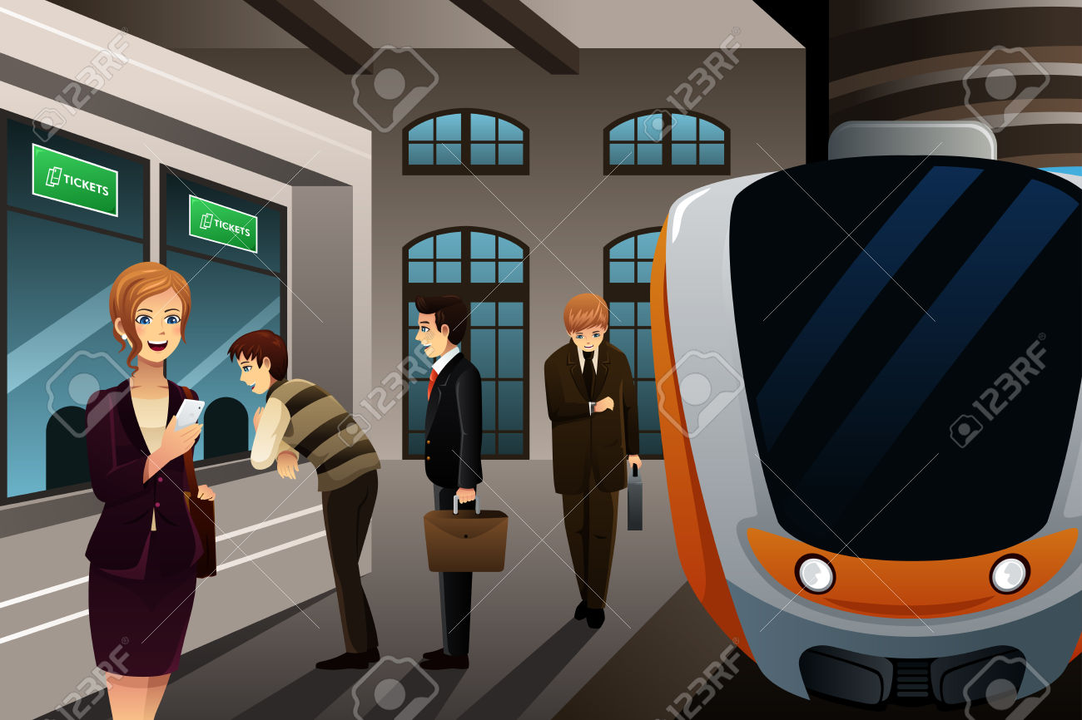
They are buying the tickets.

Slide 3
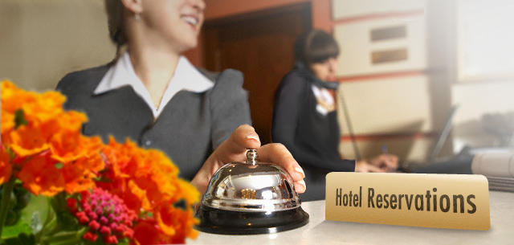
She is booking a room.

Slide 4
She is packing for a trip.

Slide 5
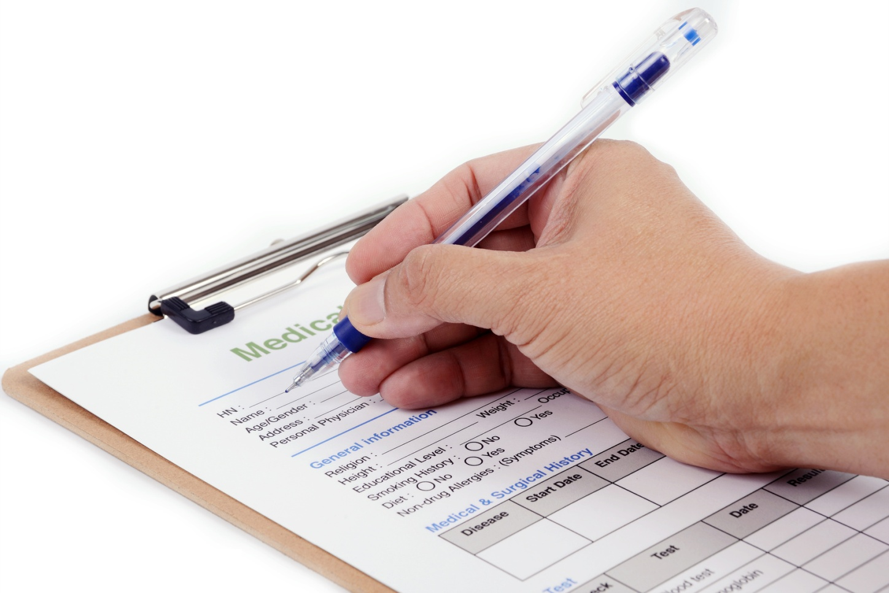
He is filling out the form.

Slide 6
The plane is tacking off.

Slide 7
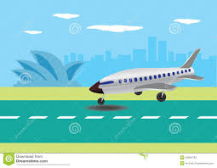
The plane is landing.

Slide 8
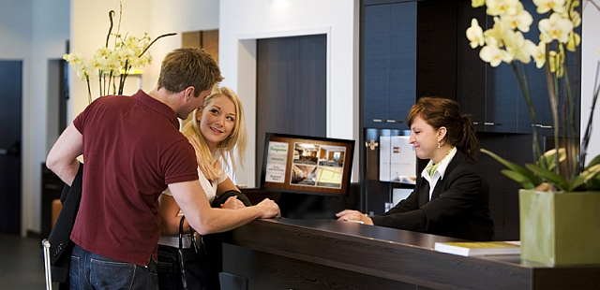
They are talking to the receptionist.

Slide 9
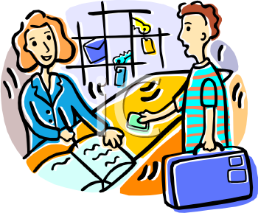
Mr. Jackson is checking in
at the hotel.

Slide 10
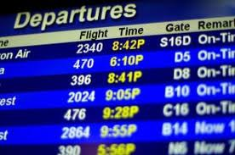
They are checking the timetable.

Slide 11
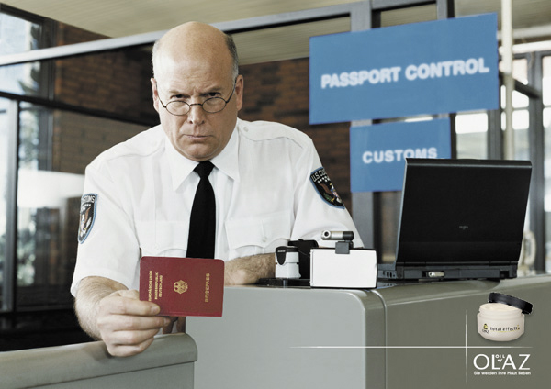
He is checking the passport.

Slide 12
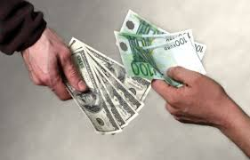
He is exchanging money.

Slide 13
Ask and answer.
Are they buying the tickets?
Yes, they are. No, they aren’t.

Slide 14
Ask and answer.
Is he/she …………………….
No, ………… . ……………………….

