Slide 1
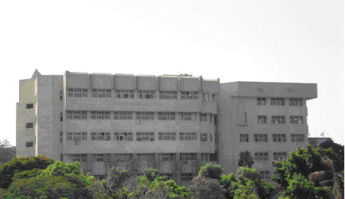
Ahmed Fawzy Zaki Mohammed
Elsayed Mohammed Abdel Shafi
Kareem El-Sayed Sheta Salem
Mohammed Abd allah Morade
Mohammed Abd El-Azim Mahmoud Elshamndy
Mohammed Hamdy khalifa
Mohammed Galal Abd El-Hakim Azab
Mohammed Shabaan Ibrahim Morsy
Mahmoud Eid Mohammed Eid
Mahmoud Mohammed Rashad
Marwa Sabry El-gendey
Mostofa Fatouh Fangary
Nadia Mohammed Attia
Naglaa Hamdy Eid Abd Rabbou
Reda Rezk Gommaa
Said Ali Mousa Solyman
Shaimaa Ali Ahmed Ahmed
Shaimaa Mohammed Abd Alaziz
Design And Calculation Of Central Air Conditioning system (using E20-II Carrier Software )
civil And architecture
engineering building

Slide 2
Step (5): Determine the internal and external design conditions.
Step (6): Estimate the thermal loads.
Step (7): calculation the rate of air flow for each zone.
Step (8): Design duct for the control A/C such, supply air lines and return air lines.
Step (9): Determine the rectangular air ducts.
Calculation the friction losses through the outlines to select air supply.
Determine the outlet air capacities for each zone.
Estimate the air ducts losses.
Calculation the cooling coils capacities to choose the cooling unit.
The bill.
Project Tasks
Step (1) Draw or study the civil and architecture building drawing sheet.
Step (2) Search for the thermal properties of the building
Step (3) Determine the compass direction (North – South. etc.)
Step (4) Calculation the usage of the different places as well as numbers of people occupancy these places.

Slide 3
Classification of Air Conditioning Apparatus
Classification of Air Conditioning Systems
Air conditioning system can be classified into two main categories as follows:
Introduction
2. Central system components:
Most large buildings, however, have their own central equipment plant and the choice of equipment depends on:
1. Unitary equipment: Unitary equipment can be divided into:-
A- Window type.
B- Split type.
Air conditioning can be defined as the control of temperature, humidity, cleanliness, odor and air circulation as required by the occupants of the space.
The factors that influence comfort, in there order of importance are:
Temperature, humidity, air motion and the quality of the air with regard to odor, dust and bacteria.
According to their function (comfort and processing air conditioning system).
According to their construction and operating characteristics
1. Required capacity and type of usage.
2. Cost and kinds of available energy.
3. Location of the equipment room.
4. Type of air distribution system.
5. Owning and operating costs.

Slide 4
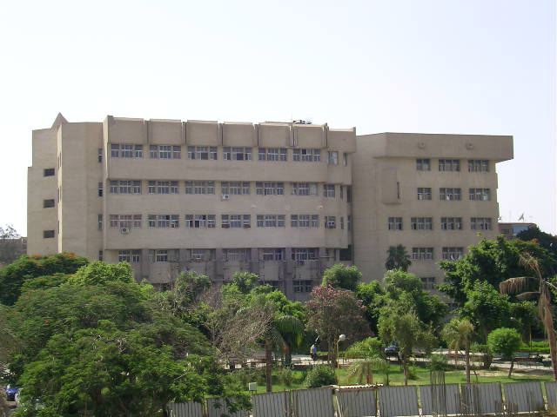
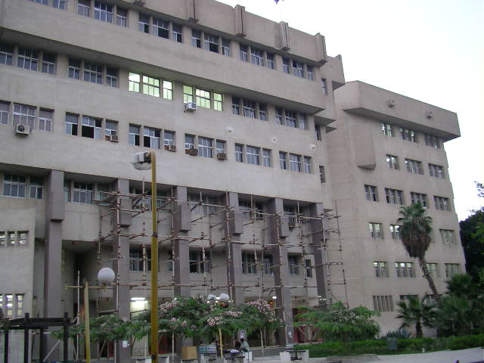
Building description
Building in the studying building for architecture and civil engineering which is located in east air shows inside the faculty of engineering (material) and has length of (69.78) m, width of (37) m, height of (35.50) m and area of (2057.86) m².
The Building Direction
In the north: District separate between this building and administration building.
In the south : District separate between this building and the shops.
In the east: Garden
In the west : AL Shahed Mustafa Hafez street
Building Design Condition
Latitude = 30
The dry outlet temperature = 37.7 º C from Carrier
The wet outlet temperature = 26.7 º C
The dry inlet temperature = 24 º C
The relative humidity = 47%
The building consist of five floor in addition to the first floor. Which consist of two amphitheater and fear hall and each floor has 20 room.
The bottoming floor includes a computer hall and one fear hall , Two amphitheater, and room and the third floor is consist of twenty room which includes two drawing hall.

Slide 5
LOAD ESTIMATING

Slide 6
Steps of Load Estimation
Calculation of
Heat Transfer Through
Wall due to
Temperature Difference
Load Calculation
due to Sun
Load Calculation
due to Equipment
Load Calculation
due to Person
Load Calculation
duo to Light
Load Calculation due to
Ventilation
Load Calculation due to
Infiltration

Slide 7
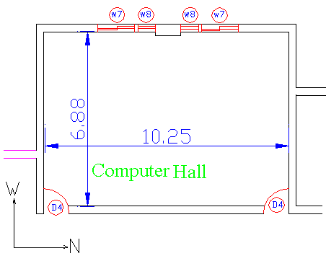
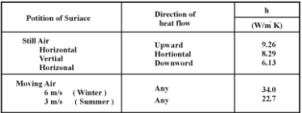
Cooling Load Calculation of the Computer Room:
Height wall:
h =5.6 m
Windows :
W₁ = 1.2*0.8 m²
W₂ = 0.6*0.8 m²
Door :
D₁=1.2*1 m²
Calculation of Heat Transfer Through Wall due to Temperature Difference :
Area Calculation:
∑area | Area | Item
2.88 | 2(1.2*0.8)+2(.6*0.8) | Glass W
2.4 | 2(1.2*1) | Door E
8.4 53 38.52 54.52 | (1.5*5.6) (10.25*5.6)-(2.4) (6.88*5.6) (10.25*5.6)-(2.88) | Wall N E S W
70.52 | (10.25*6.88) | Ceiling
Q = ∑A×U×∆T
External wall
U_{w} =1/h_{i}+1/h_{o}+∑∂/K _{i}
Internal wall
U_{w} =1/h_{i}+1/h_{i}+∑∂/K _{i}

Slide 8
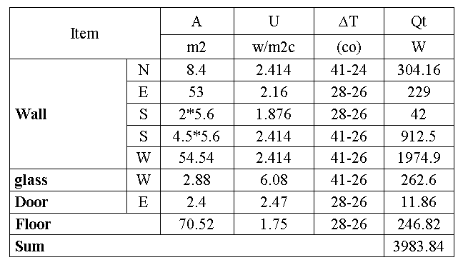
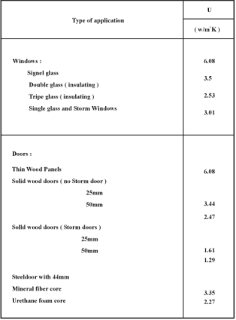
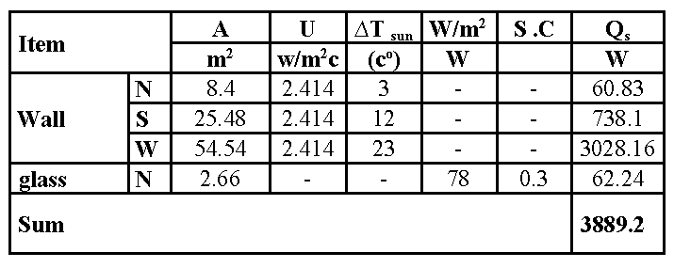
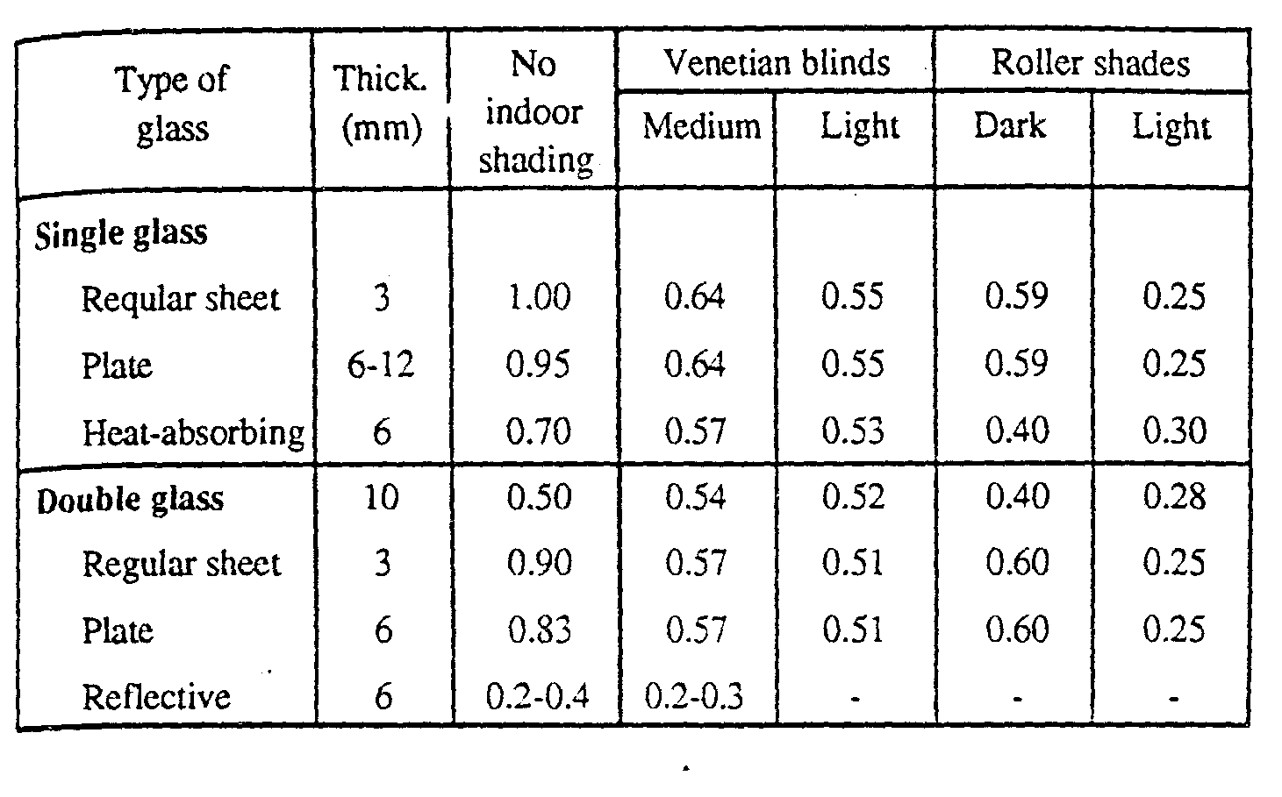
Calculation of heat transfer through wall due to temperature difference
From Table Determining the Coefficient of heat
transfer the Windows and doors
Load Calculation due to Sun:
Windows:
Single Glass = 6.08 (W/m .k)
Door :
Solid Wood Door Thickness (50mm) = 2.47 (W/m .k)
Qsun = ∑AUΔTsun + ∑A(w/m2)glass × S.C
From Table Determining the heat transfer from the sun to wall due to temperature difference.
From Table Determining the Heat transfer through glass.
From Table Determining the shadow coefficient

Slide 9
Load Calculation due to Equipment:
Load Calculation duo to Light:
QL = n×(W/lamp)×1.25
Q_{E} = ∑Q
From Table Determining the heat gain due to equipment.
Lamp length 120 cm = 40 (w/lamp)
Lamp length 60 cm = 20 (w/lamp)
QL = 70.52×40 =2820 W
Q_{E} = (18×200)+(1×150) = 3750 (W)

Slide 10
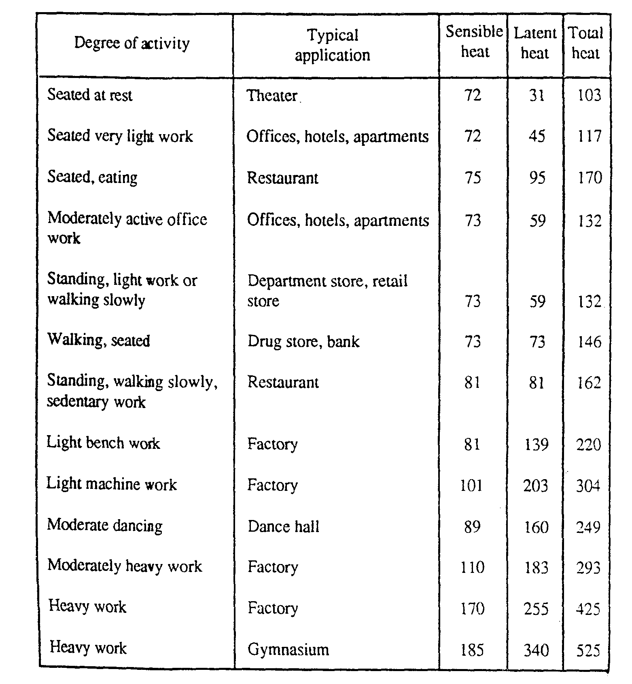
Load Calculation due to Person:
QP = n × (q/person)
From Table Determining the heat gain due to persons

Slide 11
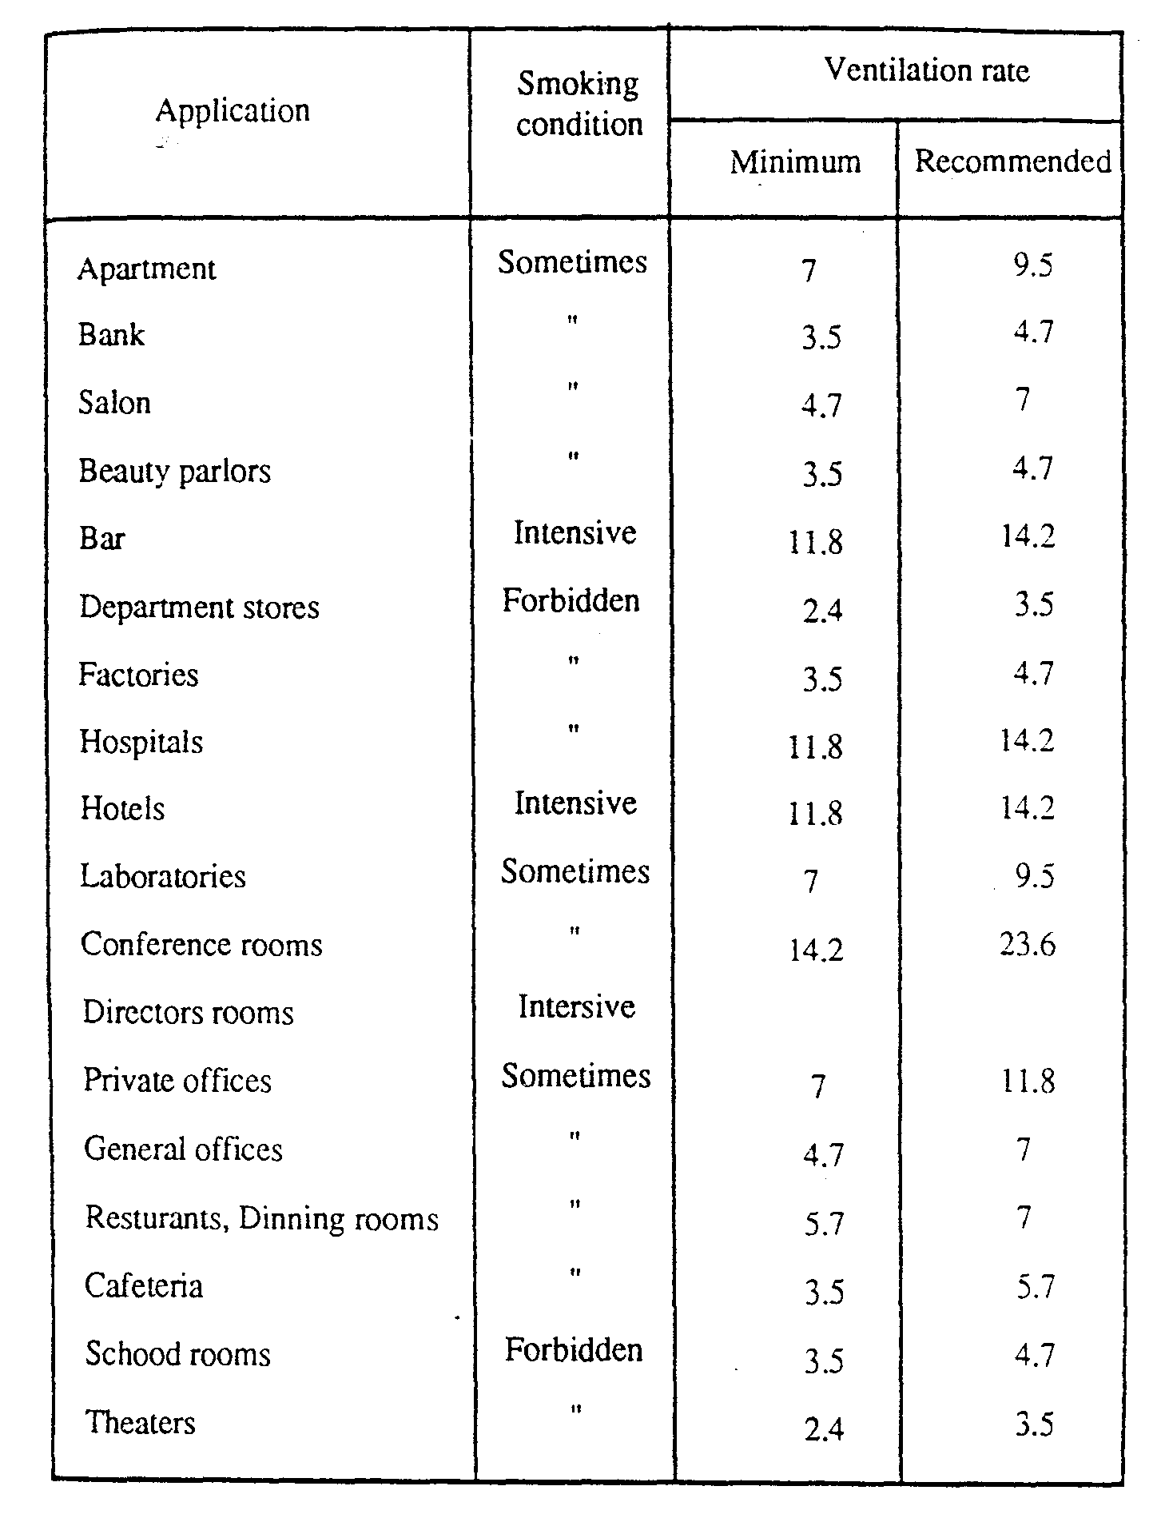
Ventilation Load Calculation :
Q v = n [(L/S/person) ×10⁻³] × (1/Vo) [(ho-hi) ×10³
Qvs= 20 × 7× 10-3× (1/0.9) × (68.4-26) × 103 = 5936 (W)
Q vl= 20 × 7× 10-3× (1/0.9) × (68.4-53) × 103 = 2156 (W)

Slide 12
Infiltration Load Calculation :
Qis = ∑L (l/s) /m ×10⁻³) × (1/vo) × (cp (to - ti) × 10³)
∑L = 2 (1.2+0.8) × 2 + 2 (0.8+0.6) × 2 = 13.6 ( m²)
∑L = 2 (1.2+1) 2 = 8.8 m²
Q_{is} = (13.6 × 0.82 + 8.8 × 2.8) 10⁻³ (1/0.9) (1.005 (41-26) ×10³) = 599.5 (W)
Q_{il} = ∑L (l/s) /m ×10⁻³) × (1/vo) × (ho – hi) 10³
Q_{il} = ((13.6×0.82) + (8.8×2.8) 10⁻³ (1/0.9) (64.4-53) 10³ = 453 (W)
Neglect infiltration load calculation

Slide 13
Summation sensible and latent load
Qt | Ql | Qs | Item
3983.84 |  | 3983.84 | Qt
3889.2 |  | 3889.2 | Qsun
3750 |  | 3750 | Qeq
2820 |  | 2820 | Qlit
2340 | 900 | 1440 | Qp
8092 | 2156 | 5936 | Qv
24.875 kW | 3.056 kW | 21.819 kW | ∑Q

Slide 14
Block Load Program

Slide 15
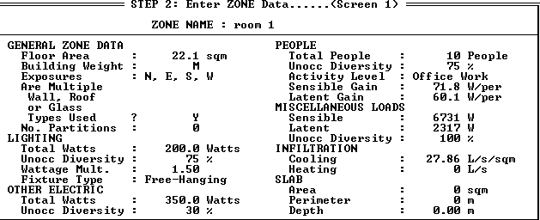
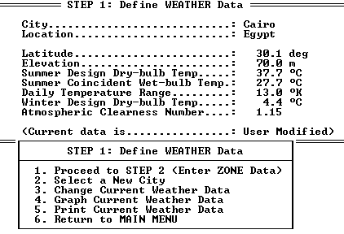
:Zone nameRoom
Step 2 : Enter zone data ……(screen 1)
STEP 1: Define Weather Data

Slide 16
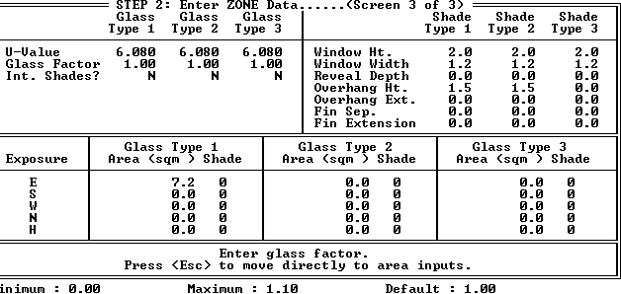
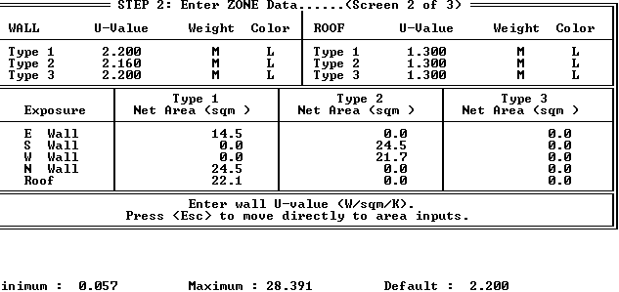
2 : Enter zone data …..(screen 2 of 3 )Step
Step: 2 Enter zone data …….. (screen 3 of 3)

Slide 17
Step 3 : define HVAC system data …(Screen 1 of 2)
Step 4: calculation load

Slide 18
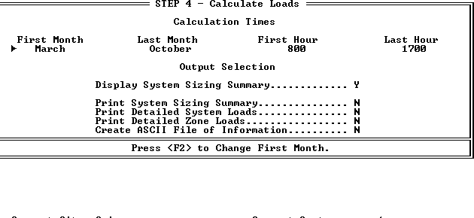
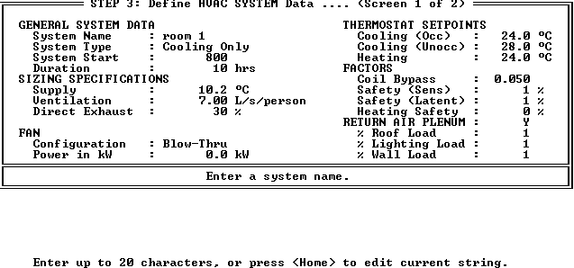
Step 3: define HVAC data ……(screen 1 of 2)
Step 4 : calculate loads

Slide 19
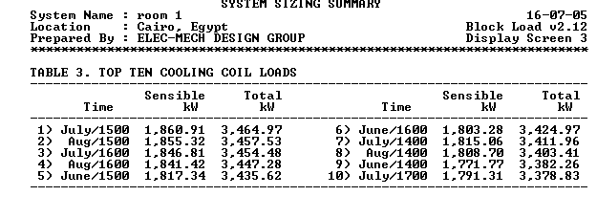
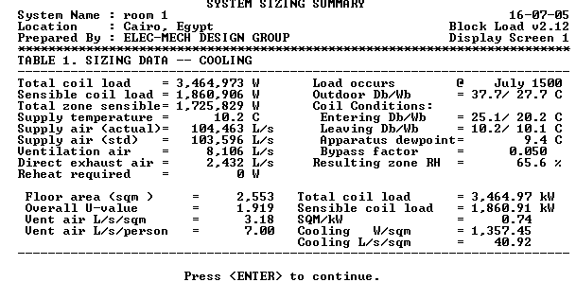
System sizing summary

Slide 20
[E20-II] HVAC PROGRAM
DESIGN
E20-II is a family of HVAC system engineering
design and analysis programs developed by
Carrier Corporation for use on microcomputers.
These takes include cooling and heating load estimating, duct system design. Piping design.

Slide 21
The E20-II family of programs consists of two basic elements:
The E20-II configuration program
The E20-II HVAC Design Programs

Slide 22
Block Load Program
Block load is computer program which calculates cooling and heating loads for buildings.It also providesdata required to size and select cooling and heating equipment.

Slide 23
To calculate loads and size equipment, a simple 4-step procedure is required. Block load is structured to guide the user guide and easily through these steps
Step 1 Defining Weather Data
Step 2 Entering Zone data
Step 3 Defining HVAC System Data
Step 4 Calculating loads

Slide 24
Air Duct Design

Slide 25
1-Introduction
Air distribution systems transmit the air from the air conditioning equipment to the space to be conditioned, and then back to the equipment. The simplest combination of fans, duct and outlets usually results in the best system.

Slide 26
2- Types of Air Duct
A-Supply duct:
conditioned air is supplied to the conditioned space.
B-Return duct:
spaces air is returned to the fan room
C-Outdoor air duct :
outdoor air is transported to the air handling unit, to the fan room.
D-Exhausted duct :
spaces air or contaminated air is exhausted from the space

Slide 27
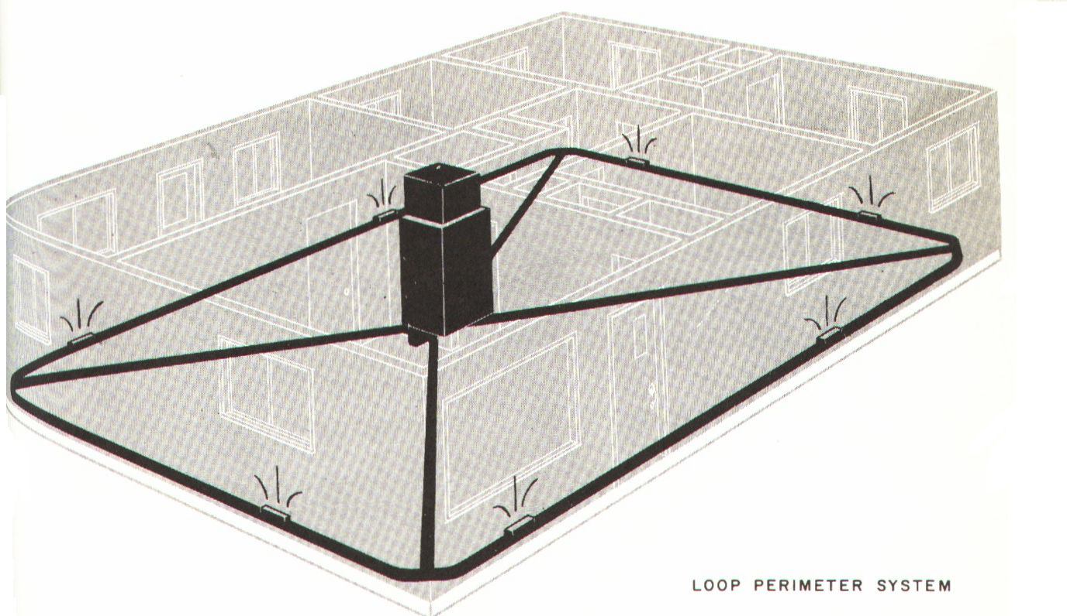
3- Duct system
A- loop perimeter :
In a loop perimeter, the supply duct is installed in a continuous, closed loop around the perimeter of the building.

Slide 28
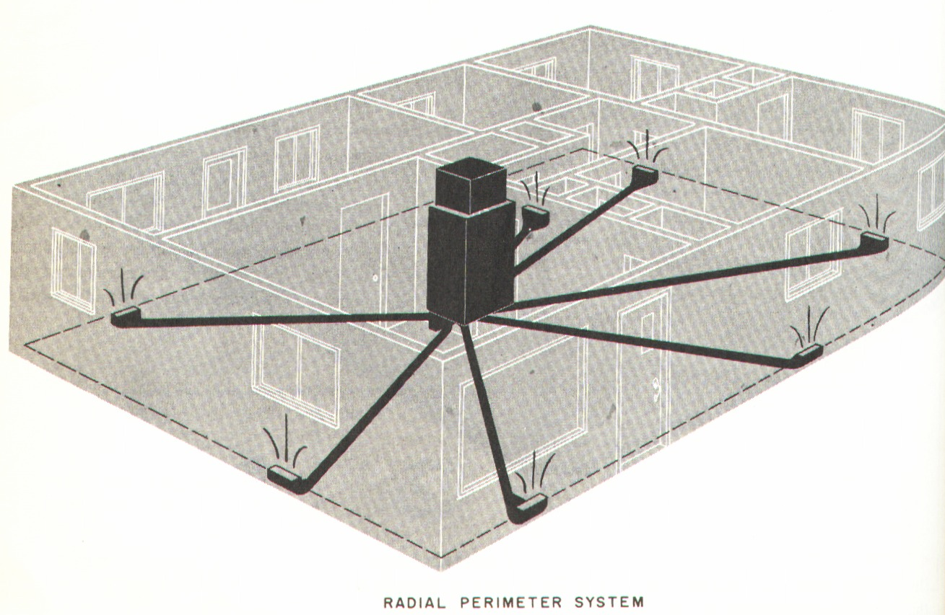
B- Radial perimeter
In a radial perimeter system, the supply air is delivered from a central plenum in separate ducts running from the plenum to each outlet.

Slide 29
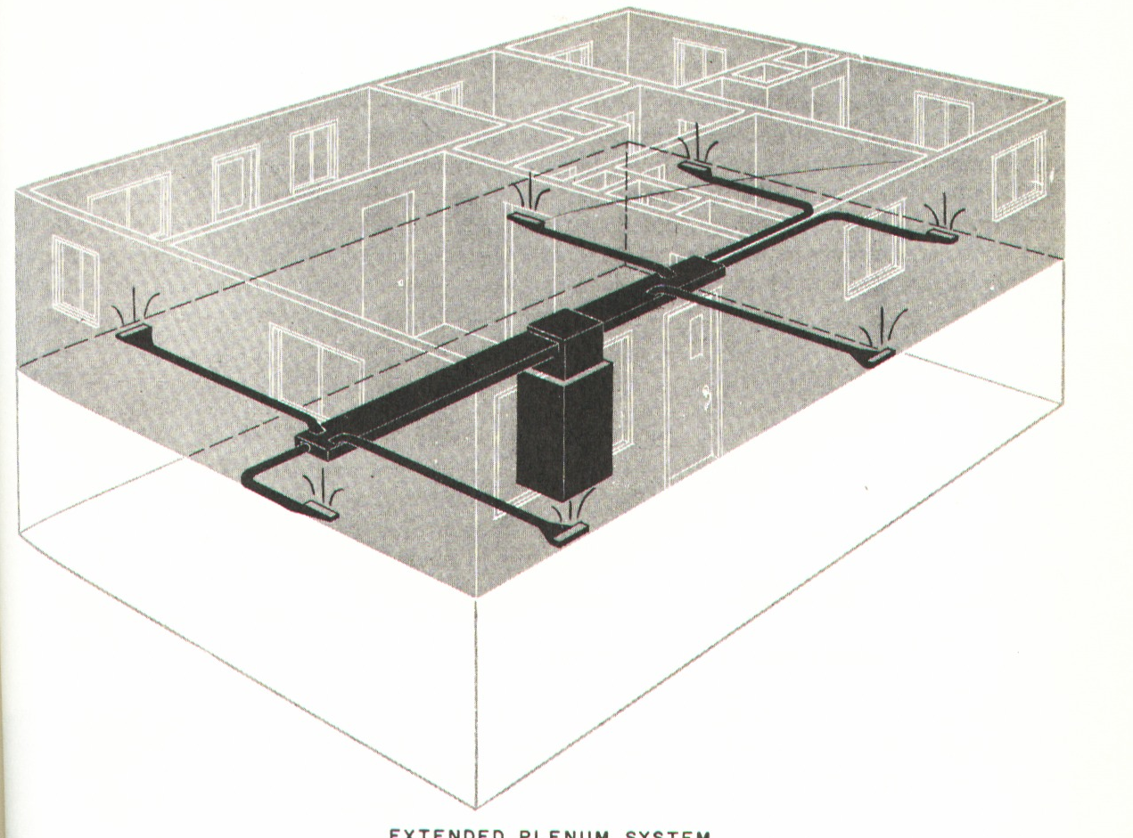
C- Extended plenum
An extended plenum system has a rectangular plenum extended from one or both sides of the heating or cooling source

Slide 30
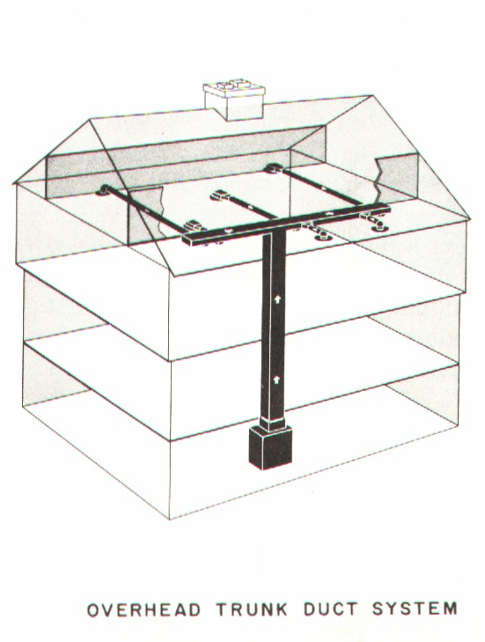
D-Overhead trunk
In an overhead trunk system the main plenum or trunk is extended in a false ceiling usually down a center hall

Slide 31
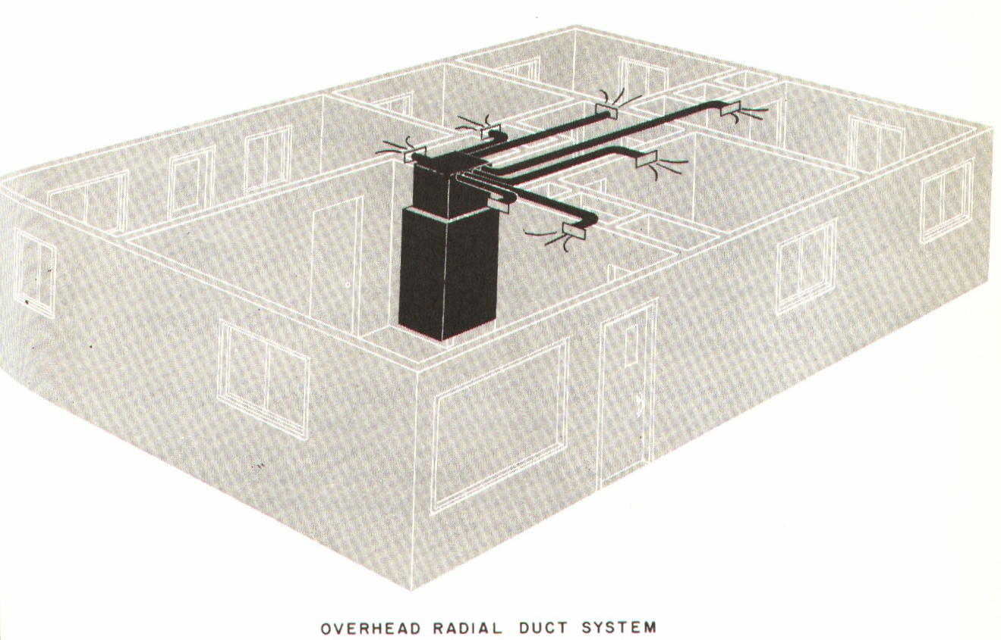
E-Overhead radial
The overhead radial system does not have an extended plenum. The supply air flows directly from the central plenum through duct located in a (false) hall ceiling.

Slide 32
4- The steps of air duct design
A- Determining the quantity of air required for each room by using this relation :
Q = 1.232 V ∆T
Q: Thermal load (summation of sensible heat and latent heat) (kW)
V: Volume flow rate of supply (cms)
∆T: temperature difference between the indoor temperature and supply air temperature

Slide 33
B-Determining the number of diffusers and its distribution through each room according to:
1- Area of the room .
2-The quantity of air .
3-The recommended noise level .
C- Select duct system suitable for our design .

Slide 34
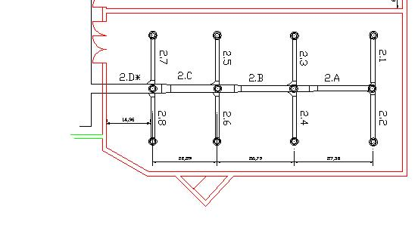
D- According to distribution we can determine the quantity of air for each duct

Slide 35
E- Duct sizing: we can use one of the following methods :
1- Equal friction method with maximum velocity .
2- Static regain method .
3- Constant velocity method .
4- T method .

Slide 36
By using equal friction method with maximum velocity we can determine the
Friction equivalent diameter.
Friction losses chart
Velocity
line
Diameter
line

Slide 37
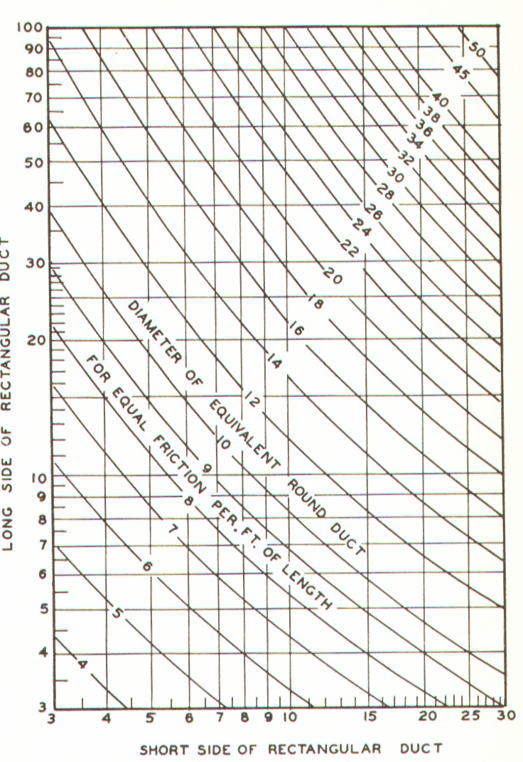
F- By using equivalent diameter chart, we ca determine dimension of rectangular duct.

Slide 38
g- Calculation of the fan power by determining the following :
a- volume of air required to supply.
b- The pressure drop (fittings, grilles, filters, coils...) in index run .
By using this relation we can determine the amount of the fan power P= Δp* V/ ή
Δp: The pressure drop
V : Volume flow rate of supply
ή :efficiency of fan

Slide 39
Air duct design by Carrier software(E20-II)

Slide 40
Step (1)

Slide 41
Step (2)

Slide 42
Step (3)

Slide 43
Step (4)

Slide 44
Step (5)

Slide 45
Step (6)

Slide 46
Step (7)

Slide 47
Step (8)

Slide 48
Step (9)

Slide 49
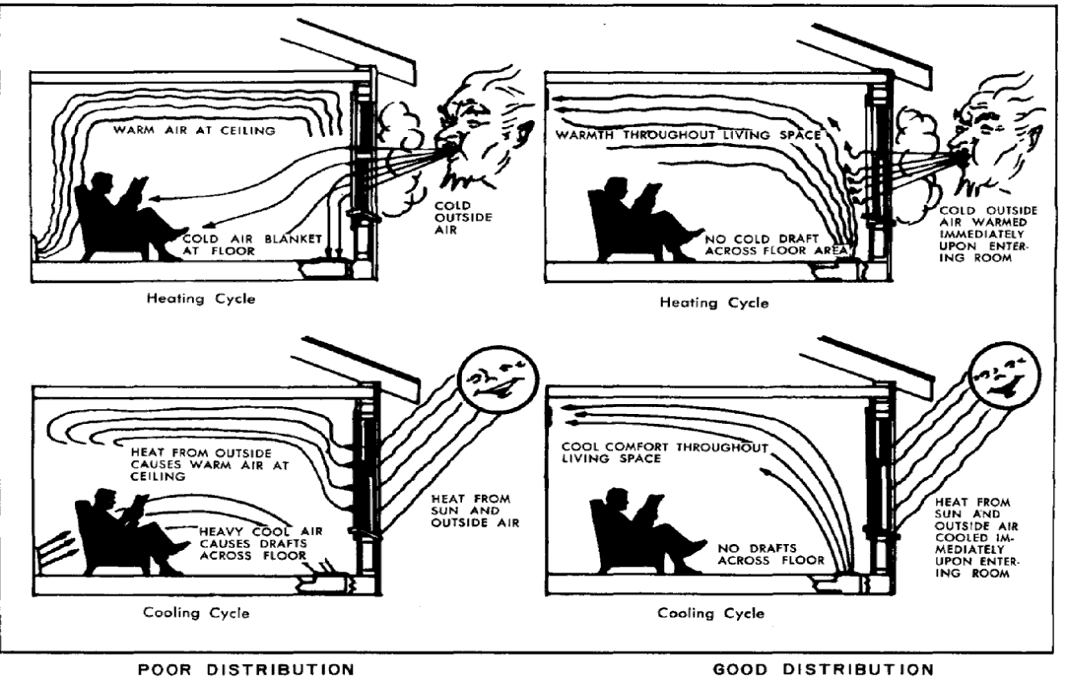
ROOM AIR DISTRIBUTION
This chapter discusses the distribution of conditioned air after it has been transmitted to the room.
Requirements necessary for
A good distribution
Temperature
Air velocity
Air direction

Slide 50
Temperate
A. Primary Air
Primary Air is defined as the conditioned air discharged by the supply outlet plus entrained room air
B. Total Air
Total Air is defined as the mixture of primary air and entrained room air

Slide 51
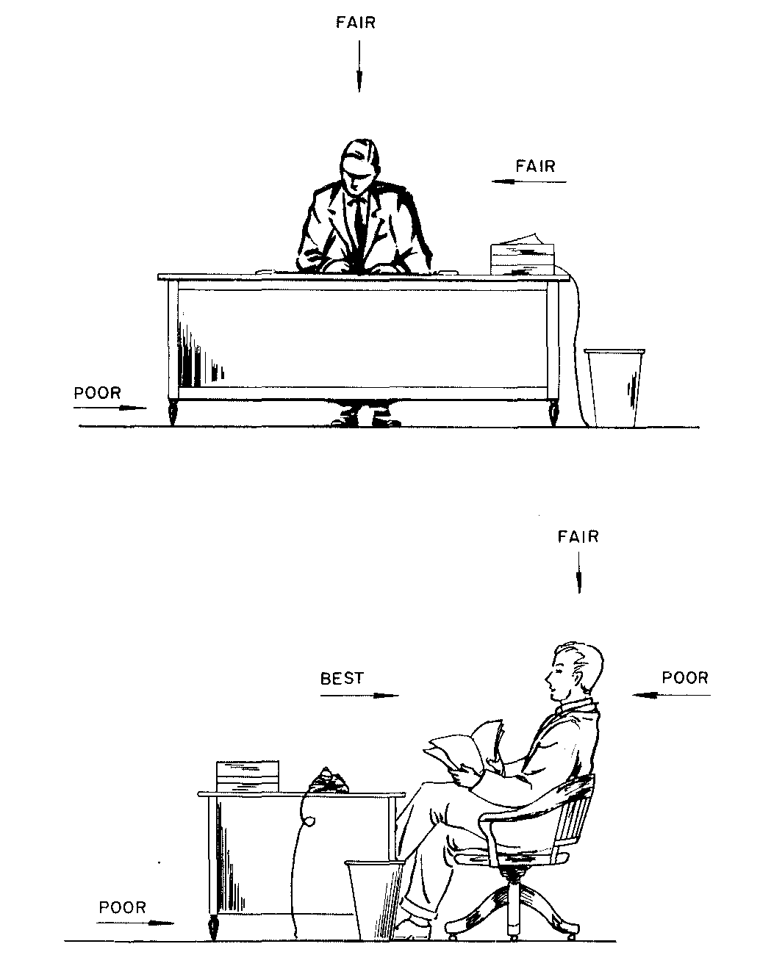
AIR DIRECTION
Air motion is desirable and actually necessary.
Fig is a guide to the most desirable air direction for a seated person.

Slide 52
Outlet Types
Supply opening.
Return opening.
Ceiling diffuser.
Grille.

Slide 53
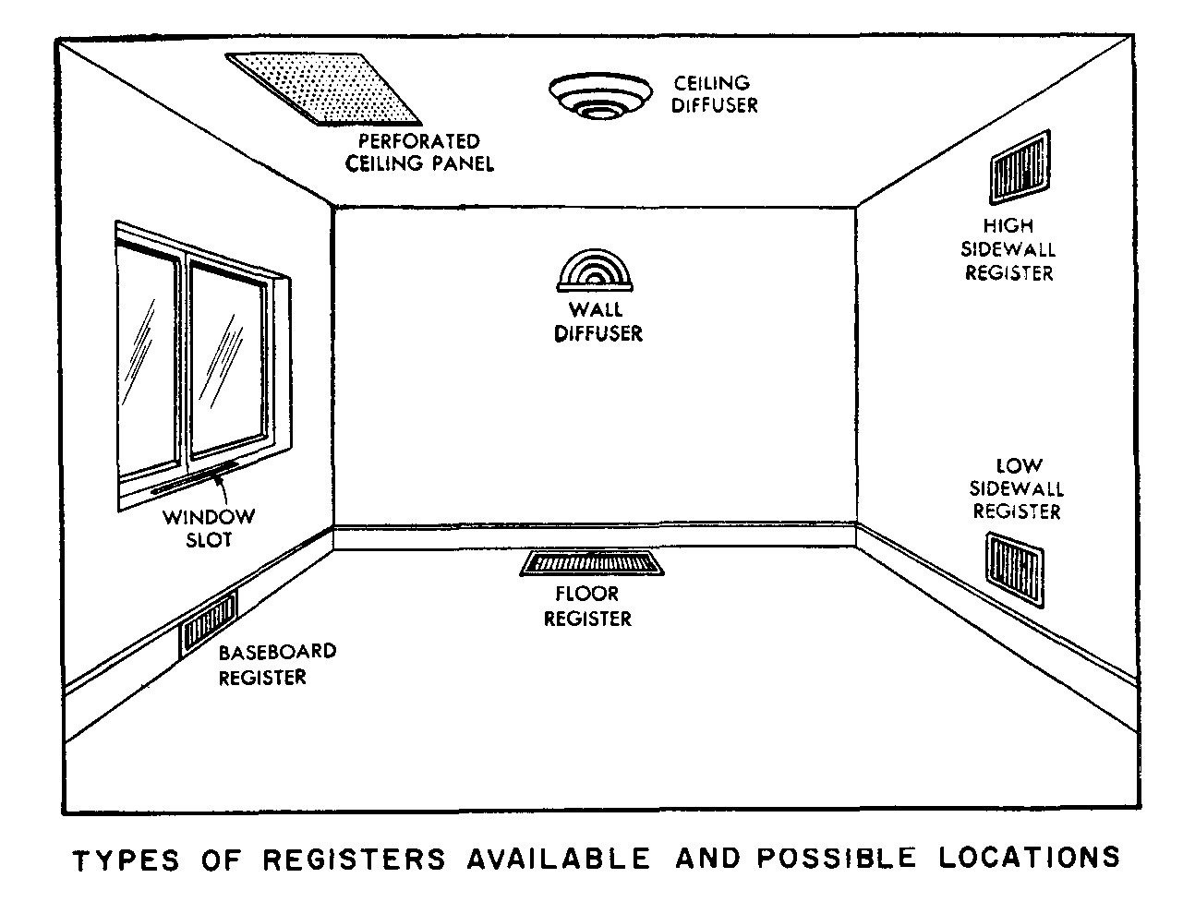
Outlet Locations
Low Wall outlets.
High Wall outlets.
Ceiling Diffuse.
Window outlets.
Floor outlet.

Slide 54
Shapes of Used Ceiling Diffusers

Slide 55
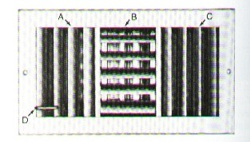
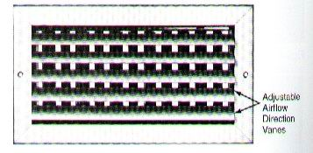
Shapes of Wall Diffusers

Slide 56
Selection of outlets
Selection of outlets according to:
The air flow rate for every room
Size of outlet
Shape of outlet
Noise level

Slide 57
FANS
Are used to move air through ducts and to induce air motion in the space .

Slide 58
Types of fans
Centrifugal Fans
Axial Fans

Slide 59
1.Centrifugal Fans
In which the air flows radially through the impeller
It is used in most comfort applications because of its wide range of quiet

Slide 60
2.Axial Fans
In which the air flows axially through the impeller
are excellent for large air volume applications where higher noise levels are of secondary concern

Slide 61
Fan selection
To select fan it is necessary to know
the capacity
the efficiency
the size and the weight
The speed and the noise
The cost

Slide 62
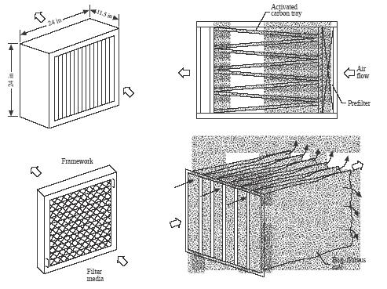
Air Cleaning and Filtration
Filtration can be defined as the process of separating dispersed particles from a dispersing fluid by means of porous media.

Slide 63
Air Contamination
Dusts
Fumes
Smokes
Mists and Fogs
Vapours and Gases
Organic Particles

Slide 64
Air Filtration
Types Of Filters:
1- Dry Filters.
2- Wet Filters.
3- Electric Filters.
4- Viscous Filters.
5- Electronic Filters.
6-Centrifugal collectors

Slide 65
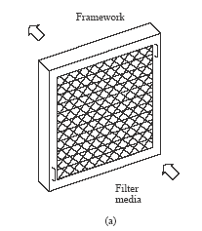
Shapes Of Some Filters
1- Dry Filter.

Slide 66
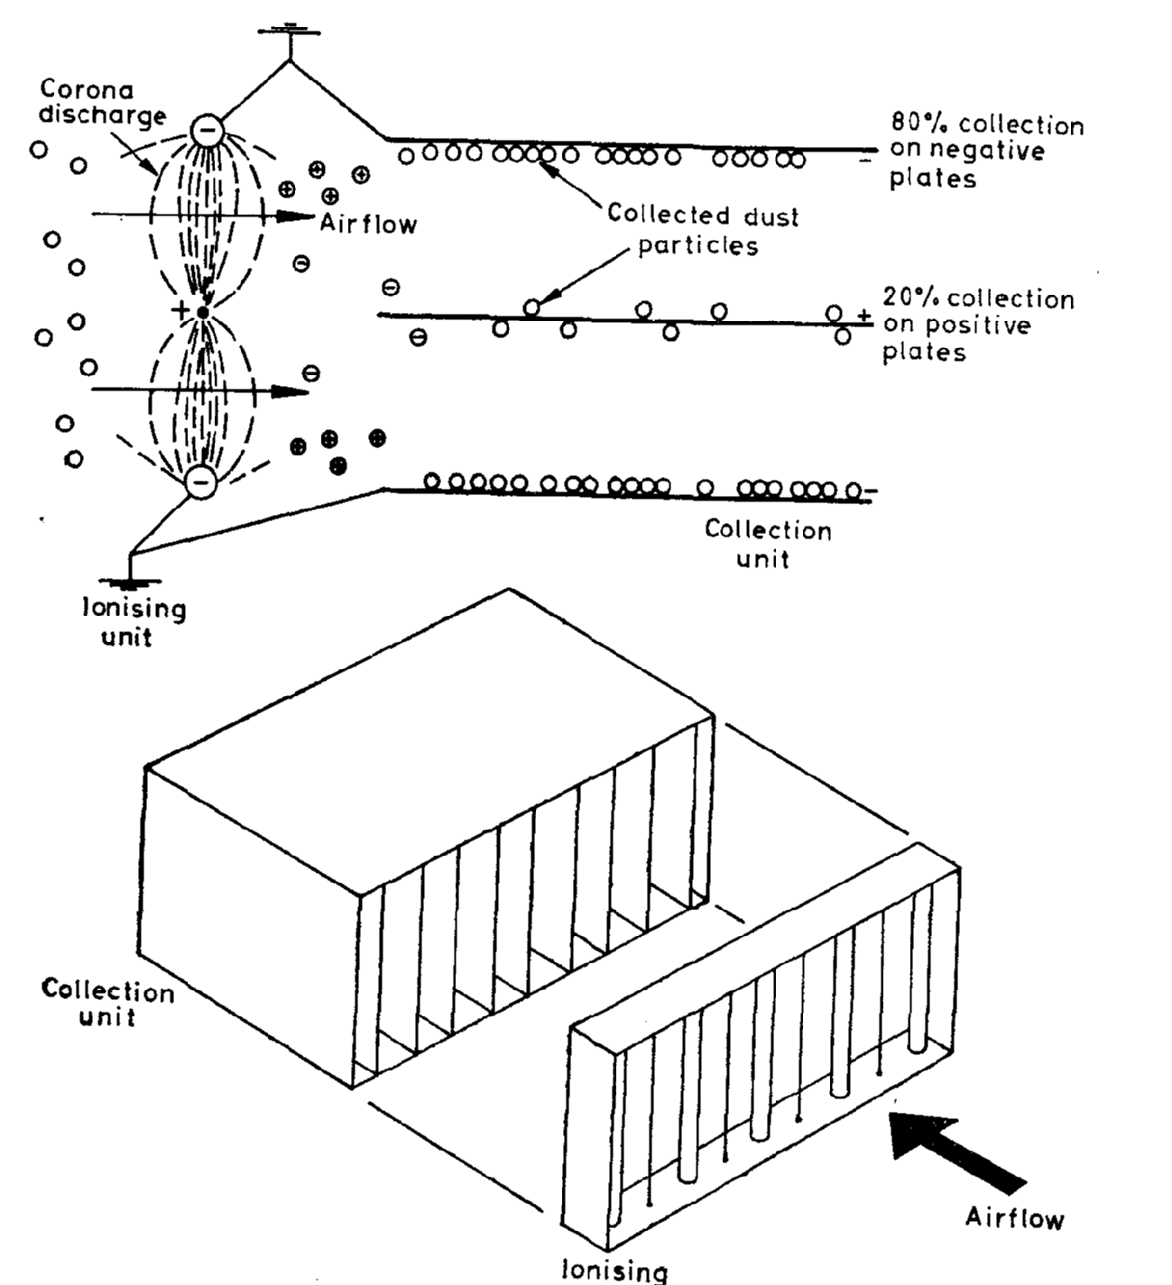
2- Electric Filter.

Slide 67
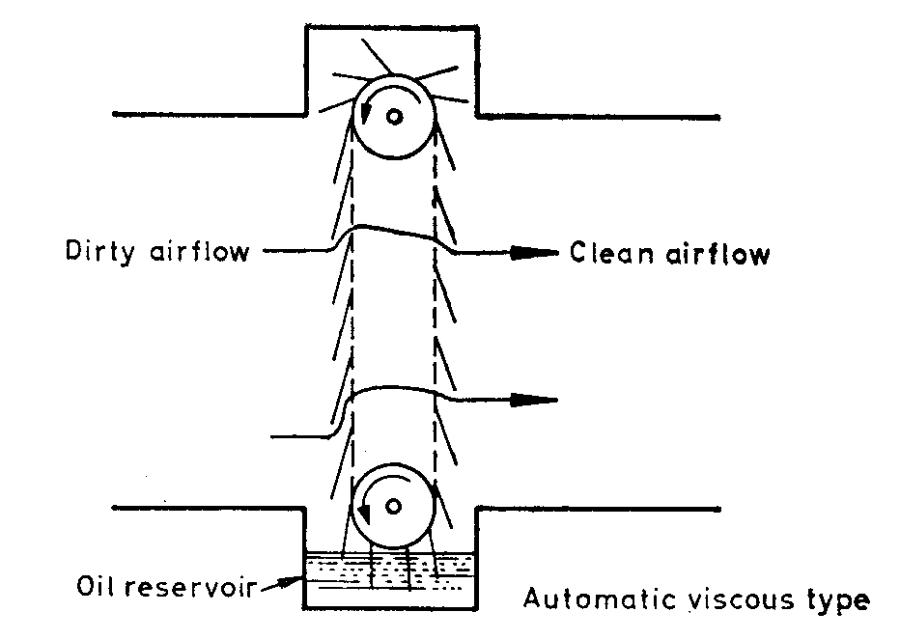
3- Viscous Filters.

Slide 68
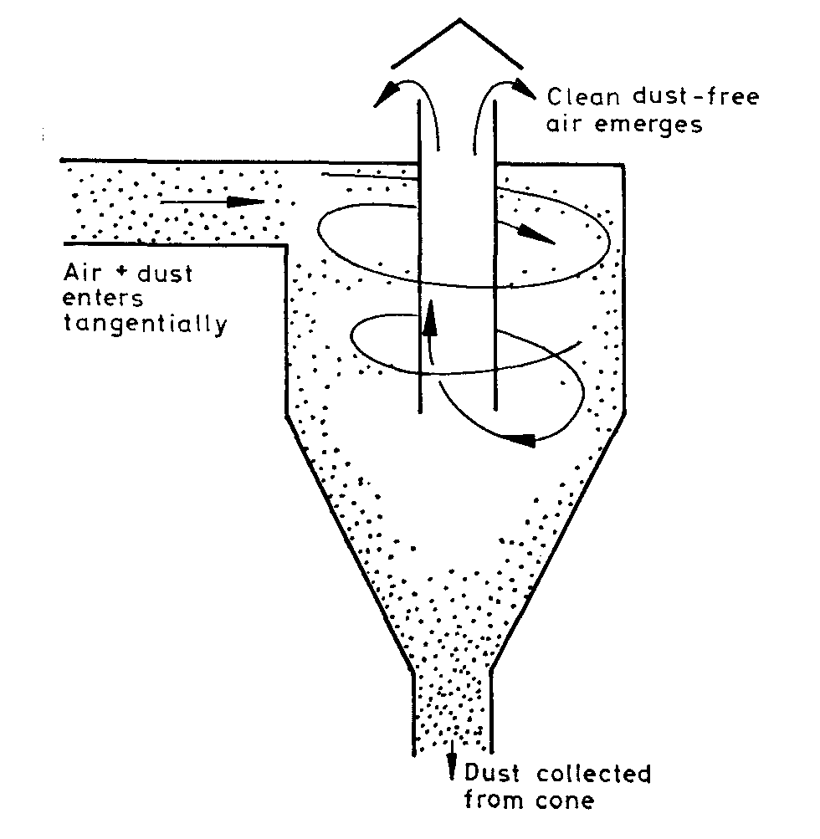
4-Centrifugal collectors

Slide 69
A Liquid Chiller is a Central Air Conditioning System

Slide 70
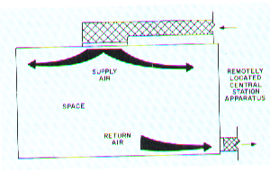
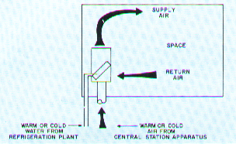
TYPES OF the SYSTEMS
Direct expansion
All - water
All - air
Air - water
Heat pump

Slide 71
System Used in Project
Advantages All Air System
All Air System
Multi - Zone
Draw Through Coil
Constant Air Volume & Variable Temperature system
Roof – Top
Medium Capacity
Design Simplicity and Operating
Low Primacy Cost
Operating Composure and Maintenance central

Slide 72
Types of Liquid Chillers
Water cooled chillers require cooling tower, city
water, river water or other source of water to operate.
Air Cooled Chillers
Water Cooled Chillers
Evaporative Cooled Chillers
Lower condensing temperatures provide longer life of compressor
Lower condensing temperatures save energy, approximately 20-25% over air cooled chillers
There are no condenser fan motors, only condenser water pump and cooling tower fan
move the ambient air. However, power usage is
higher, due to the condenser fan motors
(in addition to the compressor motors) which are
required to move the ambient air.
Depending on ambient temperatures, condensing
temperatures of 120° to 140° F are required.
Air cooled chillers are the most commonly used due to convenience of low maintenance.
Highest efficiency, lowest operating costs
Longer equipment life

Slide 73
Chillers unit used in project
Water Cooled Chiller
Calculation
Selection Chiller
Selection pump

Slide 74
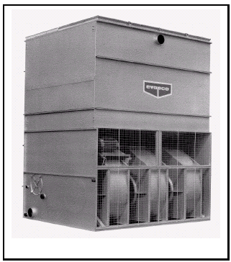
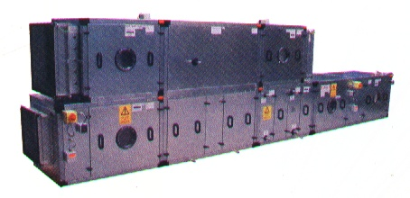
Water Cooled Chiller
Air inlet
Air outlet
Air handing unit
pump
Evaporative
Cooling tower
Expansion valve
pump
CONDENSERS
Compressor

Slide 75
Calculation Chiller Plant Design
1-Calculation the cooling load

Slide 76
2- Calculation the power compressor
3- Calculation the mass flow rate of water to cooling coil

Slide 77
Selection Chiller
Nomenclature
YC W S 0423 S C 50 Y B
YOR WATER SCREW NOMINAL STANDARD REFRIGERANT VOLTAGE TYPE DESIGN
COOLED COMPRESSOR CAPACITY EFFICIENCY R22 CODE START SERIES

Slide 78
GUIDE TO SELECTION
Design cooling capacity kW
Entering and leaving chilled water temperatures
Entering and leaving condenser water temperatures
Chilled water flow l/s if one of the temperatures
Condenser water flow l/s if one of the temperatures
Cooler and condenser fouling factors Determine the capacity
Selection Data
5C | Chilled water range
432 kW | Capacity of one unit ( kW)
6 | Number of unit

Slide 79
UNIT : YCWS 0563SC

Slide 80
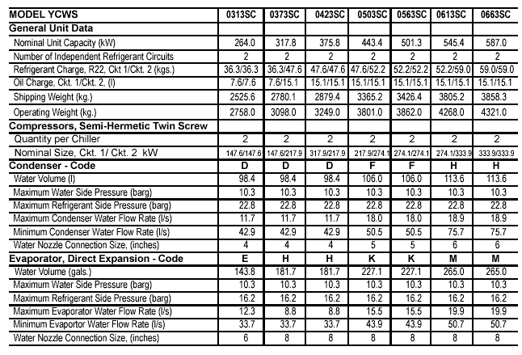
Correction
Physical Data
EVAPORATOR
CONDENSER

Slide 81
Selection pump
Selection pump Evaporator
The chilled water flow= 21 l/s
Number of pump evaporator = 6
Total chillers water flow = 6 *21 = 126 l/s

Slide 82
Selection pump Condenser
The chilled water flow= 27 l/s
Number of pump evaporator = 6
Total chillers water flow = 6 *27= 162 l/s

Slide 84
control systems
Introduction
The purpose of this chapter is to discuss the design of control systems for central air conditioning of Civil Architectural engineering building.
First of all, the term (HVAC) means heating, ventilating and air conditioning which covers a wide range of equipment.

Slide 85
Aims of Control
1. To regulate the system so that comfortable conditions are maintained in the occupied space.
2. To operate the equipment efficiently.
3. To protect the equipment and the building from damage and the occupants from injury .

Slide 86
Basic components of control systems
Valves for liquids
Valves for control air
Dampers to restrict the flow of air
Manual pressure regulator for control air
Pressure regulators for working fluids, e.g., steam
Differential-pressure regulators
Velocity sensors
Thermostats
Temperature transmitters
Receiver-controllers
Humidistat
Master and sub master controllers
Reversing relays for control pressure
Pressure selectors
Pneumatic electric switches
Freeze stats

Slide 87
ENERGY SOURCES FOR CONTROL SYSTEMS
Electric Systems
Electronic Systems
Pneumatic Systems
Hydraulic Systems
Fluidic Systems
Self-Contained System

Slide 88
PNEUMATIC CONTROL DEVICES
Pneumatic controls are powered by compressed air, usually 102 to 135 kpa which used for operating very large valves or dampers.
Relay-Type Controllers
Bleed-Type Controllers

